Slide 1
Maternity theory
A.L.ALYAA HUSSEIN ALI

Slide 2
Prenatal Care
Prenatal care refers to the care that is given to an expected mother from time of conception is confirmed until the beginning of labor.
Prenatal care has the potential to reduce the incidence of preterm birth and congenital anomalies and the infant mortality rate.

Slide 3
The purposes of prenatal care
Establish a baseline of present health
Determine gestational age
Monitor fetal development
Identify the woman at risk for complications
Minimize the risk of possible complications
Provide time for education, which will relieve fear and anxiety

Slide 4
Schedule of Prenatal Visits (low-risk pregnancy)
Monthly until 28 weeks’ gestation.
Biweekly (every 2 weeks) from 28 weeks until 36 weeks.
Weekly from 36 weeks until delivery.

Slide 5
Nursing Care for Women During First (initial) Prenatal Visit
Determine EDD based on LMP.
Document current gestational age (gestational wheel is a tool for quick reference to current gestational age).
Document baseline vital signs.
Document height, weight, and body mass index (BMI).
Auscultate fetal heart tones.

Slide 6
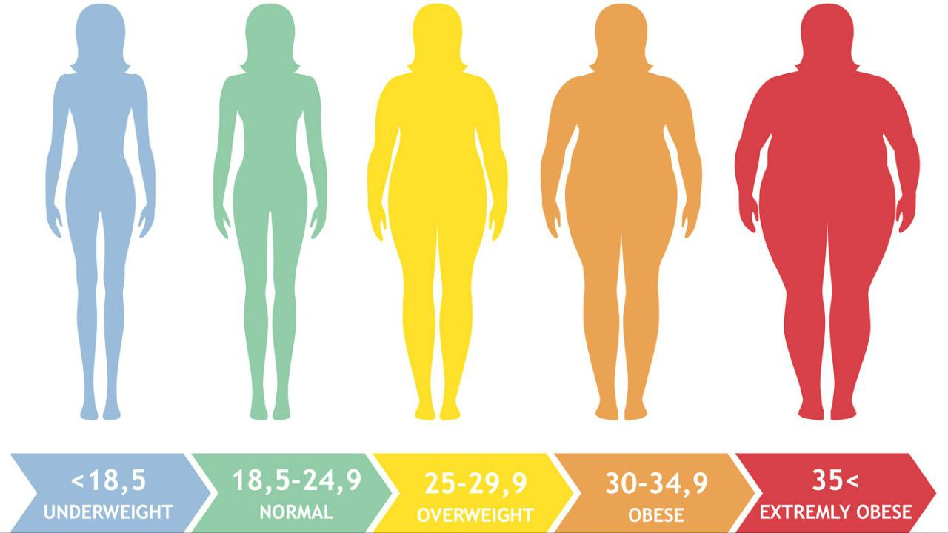

Slide 7
Measure fundal height in centimeters from symphysis pubis to the top of the fundus.
Discuss procedure for lab testing
Obtain urine specimen and blood sample.
Provide appropriate education for gestational age

Slide 8
Education in the Early Prenatal Period
Teratogens are substances that are harmful to the developing fetus; advise patient to avoid exposure.
Nutrition, encourage daily prenatal vitamin with 400 _g folic acid
Suggest 6–8 glasses of water daily.

Slide 9
Recommended weight gain depends on pre-pregnancy weight/BMI.
Physical activity in pregnancy is recommended unless contraindicated by medical complications.
Sex not restricted in pregnancy unless risk factors exist for bleeding or preterm labor.
Elevated estrogen and progesterone levels in early pregnancy generate changes in the body, causing pregnancy associated discomforts.

Slide 12
Danger Signs During Pregnancy

Slide 13
No. | Warning Sign | Possible Cause
1 | Vaginal bleeding | 1. Abortion 2. Placenta previa or Abruptio placenta 3. Preterm labor
2 | Leakage of vaginal fluid | 1. Premature rupture of amniotic fluid 2. Incontinence of urine
3 | Dysuria | Urinary tract infection
4 | Headache | Pregnancy-induced hypertension (PIH)
5 | Altered vision (Blurred vision | Pregnancy-induced hypertension (PIH)
6 | Abdominal cramping | Preterm labor
7 | Severe epigastric pain | Pregnancy-induced hypertension (PIH)
8 | Decreased fetal movement | Fetal demise
9 | Elevated temperature | Infection
10 | Persistent vomiting | Hyperemesis gravidarum

Slide 14
Nursing Care for Return Prenatal Visits
Measure pulse and blood pressure (BP)
Compare BP to initial reading (measured in the same position at each visit)
Measure weight and compare to last reading
Note total weight gain
Obtain urine specimen and test for protein and glucose
Measure fundal height

Slide 15
Determine fetal position and perform Leopold’s Maneuver
Monitor fetal heart tones (FHT)
Record presence of fetal movement
Assess for presence of edema.
Discuss procedure for diagnostic testing
Provide patient education appropriate for gestational age

Slide 17
Education in the Return Prenatal Visits
1. Teach patient to count fetal movement and report change in fetal movement pattern to primary health-care provider
2. Discuss fetal growth and development
3. Demonstrate palpating for contractions
4. Discuss symptoms of preterm labor
5. Differentiate between true and false labor
6. Encourage childbirth preparation class
7. Discuss options for pain control in labor

Slide 18
Minor discomforts during late pregnancy (Second and Third Trimester)

Slide 22
 |  |  |  | 1. | Related to upward diaphragmatic
 |  |  |  |  | pressure exerted by the gravid uterus
9. |  |  | Shortness of breath | 2. | Allow more time for strenuous
 |  |  |  |  | activities
 |  |  |  | 3. | Eat small, frequent meals
 |  |  |  | 4. | Lightening will lessen symptoms
 |  |  |  | 1. | Related to fetal movement, nocturia
10. |  |  | Insomnia | 2. | Teach relaxation techniques
 |  |  |  | 3. | Encourage side-lying with pillow
 |  |  |  |  | supports
 |  |  |  | 4. | Warm milk/shower before sleep
 |  |  |  | 1. | Related to uterine pressure on the
11 |  |  | Leg cramps |  | pelvic nerves or calcium imbalance
 |  |  |  | 2. | Review daily calcium intake
 |  |  |  | 3. | Teach signs of deep vein thrombosis
 |  |  |  | 1. | Related to decreased gastric motility;
 |  |  |  |  | iron supplement may worsen
12. |  |  | Constipation / Hemorrhoids |  | constipation
 |  |  |  | 2. | Increase dietary fiber and water intake
 |  |  |  | 3. | Encourage exercise
 |  |  |  | 4. | Discourage enemas and laxatives

Slide 23
Nursing Diagnosis
Examples of nursing diagnoses involving the changes that occur with pregnancy are:
Anxiety related to unexpected pregnancy.
2.Altered breathing pattern related to respiratory system changes of pregnancy.
3.Disturbed body image related to weight gain with pregnancy.
4.Deficient knowledge related to normal changes of pregnancy.
5.Imbalanced nutrition, less than body requirements, related to early morning nausea.

Slide 24
6.Risk for ineffective coping related to confirmation of unplanned pregnancy.
7.Health-seeking behaviors related to guidelines for nutrition and activity during pregnancy.
8.Deficient knowledge regarding exposure to teratogens during pregnancy.
9.Risk for injury to fetus related to current lifestyle behaviors.

Slide 25
References:
Holloway, B., Moredich,C., Aduddell,K. (2006). OB Peds Notes Women’s health, Davis Company, Philadelphia, 19-51.
Perry, S. E., Hockenberry, M. J., Lowdermilk, D. L., Wilson, D., Alden, K. R., & Cashion, M. C. (2018). Maternal child nursing care 6th edition. Mosby. 152-201.
Perry,S.E., Hockenberry,M.J., Lowdermilk, D.L., Wilson,D. (2014). Maternal Child Nursing Care. 5th edition, Mosby, an imprint of Elsevier Inc., Canada, 169-224.
Pillitteri, A. (2010). Maternal and Child health Nursing: Care of the Childbearing and Childrearing Family, 6th edition, Lippincott Williams & Wilkins, Philadelphia, 219-268.

